Slide 1
Unit –I Introduction to Algorithm
Amrita Naik

Slide 2
Algorithm
An algorithm is finite set of instruction if followed accomplishes a particular task.
Ex:
Algorithm checkEven(n)
{
If(n%2==0)
Print “Even”
Else
Print”Odd”
}

Slide 3
Algorithm Example
Step 1: Take the brush
Step 2: Put the paste on it.
Step 3: Start brushing
Step 4: Rinse
Step 5: Wash
Step 6: Stop

Slide 4
Criteria to design efficient Algorithm
1.Input
2.Output
3.Definiteness
4.Finiteness
5.Effectiveness

Slide 5
Performance Analysis
1.Space Complexity: is the amount of memory it needs to run to completion.
Represented by S(P)
2.Time Complexity: is the amount of computer time it needs to run to completion.
Represented by T(P)

Slide 6
Space Complexity(S(P))
The space needed by each algorithm is sum of:
(i)Fixed part: Space for code, fixed variable and constants - C
(II)Variable part: Space needed by reference variable ,recursion stack - Sp
S(P)= C+Sp

Slide 7
Example1 for space complexity
C=3
Sp=0
S(P)=C+Sp=3+0=3
Algorithm abc(a,b,c)
{
return a+b+b*c+(a+b-c)/(a+b)
}

Slide 8
Example2 for space complexity
Algorithm sum(a,n)
{
s=0
for i=1 to n do
s=s+a[i]
Return s
}
C=3
Sp=n
S(P)=C+Sp=3+n

Slide 9
Example3 for space complexity
Algorithm RSum(a,n)
{
If(n<=0) then
return 0;
Else
return Rsum(a,n-1)+a[n];
}
C=0
Sp=3(n+1)
S(P)=0+Sp=0+3(n+1)

Slide 10
Time Complexity
2 methods:
1)using Global variable
2)using Tabular method

Slide 11
1)Calculate Time complexity using Count variable
Algorithm sum(a,n)
{
s=0;
count=count+1
for i=1 to n do
{
count=count+1
s=s+a[i]
count=count+1
}
count=count+1
count=count+1
Return s
}
T(n)=No of times count is incremented=1+nn+1+1
T(n)=2n+3

Slide 12
2)Using tabular method
s/e | frequency | Total steps
0 | - | 0
0 | - | 0
1 | 1 | 1
1 | n+1 | n+1
1 | n | n
1 | 1 | 1
0 | - | 0
 |  | 2n+3
Algorithm sum(a,n)
{
s=0
for i=1 to n do
s=s+a[i]
return s
}

Slide 13
Another Example
s/e | F(n=0) | F(n>0) | TS(n=0) | TS(n>0)
0 | - | - | 0 | 0
0 | - | - | 0 | 0
1 | 1 | 1 | 1 | 1
1 | 1 | 0 | 1 | 0
0 | - | - | - | -
1+X | 0 | 1 | 0 | 1+X
0 | - |  | 0
 |  |  | 2 | 2+X
Algorithm Rsum(a,n)
{
If (n<=0) then
return 0
Else
return Rsum(a,n-10)+a[n]
}
T(n)=2+2+2…n+1 times=2(n+1)

Slide 14
Another Example
Algorithm Add(a,b,c,m,n)
{
for i=1 to m do
for j=1 to n do
c[i,j]=a[I,j]+b[I,j]
}
s/e | Frequency | Total count
0 | - | 0
0 | - | 0
1 | m+1 | m+1
1 | m(n+1) | mn+m
1 | mn | mn
0 | - | 0
 |  | 2mn+2m+1
T(n)=2mn+2m+1

Slide 15
An Example of Linear Search Algorithm
Start from the leftmost element of array and one by one compare x with each element of array
If x matches with an element, return the index.
If x doesn’t match with any of elements, return -1.
Ex: Consider an array A={10,50,30,70,80,60,20,90,40}

Slide 16
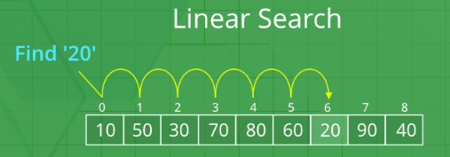
Linear Search
The best time complexity of linear search is O(1)
The average time complexity of the above algorithm is O(n)
The worst time complexity of the above algorithm is O(n)

Slide 17
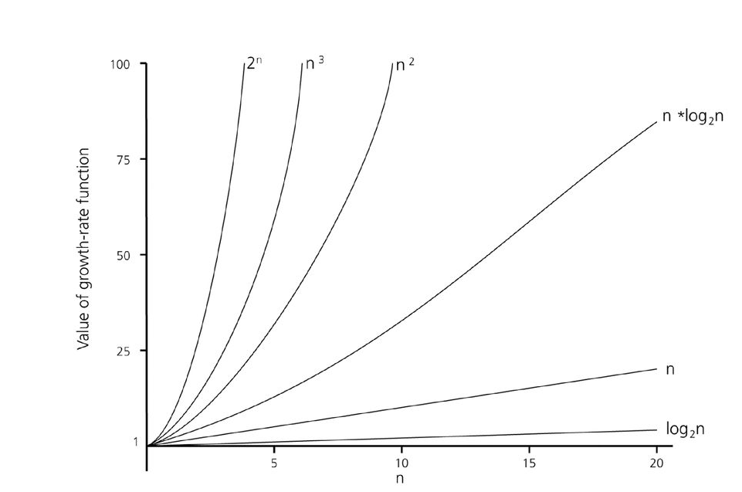
Comparison of growth function
Example of Time Complexity: T(n)=n²+2n+3

Slide 18
Asymptotic Notations
1.Big Oh(O) : “f(n) is O(g(n))” iff for some constants c and N₀, f(n) ≤ cg(n) for all N > N₀
2.Big Omega(Ω):f(n)= Ω (g(n)), iff for some constants c and N₀, f(n) ≥ cg(n) for all N > N₀
3.Big Theta(Ө):iff f(n) is O(g(n)) and f(n) is Ω(g(n))

Slide 19
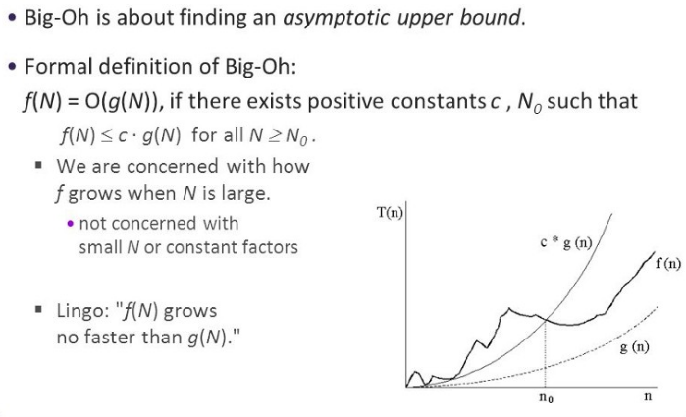
1.Big Oh(O)

Slide 20
Big Oh Example
Example: P.T 2n + 10 is O(n)
2n + 10 ≤ cn
2+10/n ≤ c [Divide both sides by n]
Pick c >=12 and n0 = 1

Slide 21
Big-Omega
f(n) is Ω(g(n)) if there is a constant c > 0
and an integer constant n₀ ≥ 1 such that
f(n) ≥ c•g(n) for n ≥ n₀

Slide 22
Big-Theta
f(n) is Θ(g(n)) if there are constants c’ > 0 and c’’ > 0 and an integer constant n₀ ≥ 1 such that c’•g(n) ≤ f(n) ≤ c’’•g(n) for n ≥ n₀

Slide 23
Different Type of Algorithm
1.Divide and Conquer
2.Greedy
3.Dynamic
4.Backtracking
5.Branch and Bound

Slide 24
1.Divide and Conquer
1. Divide the problem into two or more smaller subproblems.
2. Conquer the subproblems by solving them recursively.
3. Combine the solutions to the subproblems into the solutions for the original problem.

Slide 25
General Method
Divide_Conquer(problem P)
{
if Small(P)
return S(P);
else
{
Divide P into smaller instances P1, P2, …,
Pk;
Apply Divide_Conquer to each of these
subproblems;
Return Combine(Divide_Conque(P1),
Divide_Conque(P2),…, Divide_Conque(Pk));
}
}

Slide 26
1.Binary Search
Fastest searching algorithm which uses Divide and Conquer approach.
Search a sorted array by repeatedly dividing the search interval in half.
If the value of the search key is less than the item in the middle of the interval, narrow the interval to the lower half.
Otherwise narrow it to the upper half.
Repeatedly check until the value is found or the interval is empty.

Slide 27
Algorithm BinarySearch(a, n,x)
{
low=1, high=n
while(low<=high){
mid=L(low+high)/2 ˩
if(x<a[mid])
high=mid-1
else
{
If(x>a[mid])
low=mid+1
else
return mid
}
}
return “Not Found”
}

Slide 28
Binary Search
Binary search. Given value and sorted array a[], find index i such that a[i] = value, or report that no such index exists.
Invariant. Algorithm maintains a[lo] ≤ value ≤ a[hi].
Ex. Binary search for 33 in an array A={6,13,14,25,33,43,53,64,72,84,93,95,96,97}
6
13
14
25
33
43
51
53
64
72
84
93
95
96
97
0
1
2
3
4
5
6
7
8
9
10
11
12
13
14
lo
hi

Slide 29
Binary Search
Binary search. Given value and sorted array a[], find index i such that a[i] = value, or report that no such index exists.
Invariant. Algorithm maintains a[lo] ≤ value ≤ a[hi].
Ex. Binary search for 33.
6
13
14
25
33
43
51
53
64
72
84
93
95
96
97
0
1
2
3
4
5
6
7
8
9
10
11
12
13
14
lo
mid
hi

Slide 30
Binary Search
Binary search. Given value and sorted array a[], find index I such that a[i] = value, or report that no such index exists.
Invariant. Algorithm maintains a[lo] ≤ value ≤ a[hi].
Ex. Binary search for 33.
6
13
14
25
33
43
51
53
64
72
84
93
95
96
97
0
1
2
3
4
5
6
7
8
9
10
11
12
13
14
lo
hi

Slide 31
Binary Search
Binary search. Given value and sorted array a[], find index i such that a[i] = value, or report that no such index exists.
Invariant. Algorithm maintains a[lo] ≤ value ≤ a[hi].
Ex. Binary search for 33.
6
13
14
25
33
43
51
53
64
72
84
93
95
96
97
0
1
2
3
4
5
6
7
8
9
10
11
12
13
14
lo
mid
hi

Slide 32
Binary Search
Binary search. Given value and sorted array a[], find index i such that a[i] = value, or report that no such index exists.
Invariant. Algorithm maintains a[lo] ≤ value ≤ a[hi].
Ex. Binary search for 33.
6
13
14
25
33
43
51
53
64
72
84
93
95
96
97
0
1
2
3
4
5
6
7
8
9
10
11
12
13
14
lo
hi

Slide 33
Binary Search
Binary search. Given value and sorted array a[], find index i such that a[i] = value, or report that no such index exists.
Invariant. Algorithm maintains a[lo] ≤ value ≤ a[hi].
Ex. Binary search for 33.
6
13
14
25
33
43
51
53
64
72
84
93
95
96
97
0
1
2
3
4
5
6
7
8
9
10
11
12
13
14
lo
mid
hi

Slide 34
Binary Search
Binary search. Given value and sorted array a[], find index i such that a[i] = value, or report that no such index exists.
Invariant. Algorithm maintains a[lo] ≤ value ≤ a[hi].
Ex. Binary search for 33.
6
13
14
25
33
43
51
53
64
72
84
93
95
96
97
0
1
2
3
4
5
6
7
8
9
10
11
12
13
14
lo hi

Slide 35
Binary Search
Binary search. Given value and sorted array a[], find index i such that a[i] = value, or report that no such index exists.
Invariant. Algorithm maintains a[lo] ≤ value ≤ a[hi].
Ex. Binary search for 33.
6
13
14
25
33
43
51
53
64
72
84
93
95
96
97
0
1
2
3
4
5
6
7
8
9
10
11
12
13
14
lo hi mid

Slide 36
Binary Search
Binary search. Given value and sorted array a[], find index i such that a[i] = value, or report that no such index exists.
Invariant. Algorithm maintains a[lo] ≤ value ≤ a[hi].
Ex. Binary search for 33.
6
13
14
25
33
43
51
53
64
72
84
93
95
96
97
0
1
2
3
4
5
6
7
8
9
10
11
12
13
14
lo hi mid

Slide 37
Time Complexity –Binary Search
T(n)=T(n/2)+f(n)
=T(n/2)+c
[Base step: T(1)=c]

Slide 38
Recurrence Relation
Is an equation that recursively describes a time complexity function for an algorithm given a base step.
4 ways to solve recurrence relation:
1)Substitution
2)Iteration
3)Recursion tree
4)Master’s Theorem

Slide 39
1)Substitution
2 Steps:
1)We make a guess for the solution
2)We use mathematical induction to prove the guess is correct or incorrect.

Slide 40
Time Complexity of Binary Search using Substitution
T(n) = T(n/2) + c
T(n)=aT(n/b)+f(n)
We guess the solution as T(n) = O(Logn).
Now we use induction to prove our guess.
We need to prove that T(n) <= cLogn.
We can assume that it is true for values smaller than n.
T(n) = T(n/2) + c
= T(n/2^{i})+ ic = cLog(n/2^{i}) + ic
= cLogn - cLog2^{i} + ic
= cLogn - ci + ic =clogn
<= cLogn

Slide 41
Example of Substitution
T(n) = 2T(n/2) + n
We guess the solution as T(n) = O(nLogn).
Now we use induction to prove our guess.
We need to prove that T(n) <= cnLogn.
We can assume that it is true for values smaller than n.
T(n) = 2T(n/2) + n
= 2c(n/2)Log(n/2) + n
= cnLogn - cnLog2 + n
= cnLogn - cn + n = cnLogn – n(c-1)
<= cnLogn

Slide 42
2)Iteration Method
T(n)= T(n/2)+c
T(n)=T(n/4)+c+c
=T(n/8)+c+c+c
=T(n/16)+c+c+c+c
=T(n/32)+5c
=T(n/2⁵)+5c
=T(n/2^{i})+ic
=(c+clogn) [when n=2^{i} ,then log n=i]
T(n)>=clogn
T(n)=Ω(logn)
Time Complexity for Binary Search

Slide 43
3)Recursion Method
Time Complexity for Binary Search
n
c
n/2
x
c
n/4
x
x
x
c
n/8
x
The no of steps taken
=clogn
T(n)=O(logn)
log n
time

Slide 44
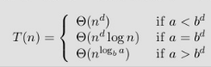
4)Master’s Theorem
Direct way of finding the solution , when the time complexity is following form:
T(n) = aT(n/b) + f(n) where a >= 1 and b > 1
Here f(n) is of the form n^{d}

Slide 45
Time Complexity for Binary Search using Master’s Theorem
T(n) = T(n/2) + c
Here a=1, b=2, d=0
a=b^{d}
Therefore T(n)=O(n^{d}logn)
=O(logn)

Slide 46
2)Another Example of Iteration
T (n) = 1 if n=1
= 2 T (n-1) if n>1
T(n)=2 *(2*T(n-2))
=2*(2*(2*T(n-3)))
=2^{K}T(n-k)
n-k=1 =>k=n-1
=2^{n-1} T(1)= 2^{n-1}

Slide 47
2)Another Example of Iteration
T (n) = 2T (n-1)
= 2[2T (n-2)]
= 2²T (n-2)
= 4[2T (n-3)]
= 2³T (n-3)
= 8[2T (n-4)]
= 2⁴T (n-4) ------------------------- (Eq.1)
Repeat the procedure for i times T (n) = 2^{i} T (n-i) Put n-i=1 or i= n-1 in (Eq.1)
T (n) = 2^{n-1} T (1) = 2^{n-1} .1 {T (1) =1 .....given}
= 2^{n-1}

Slide 48
2)Another Example of Iteration
T (n) = T (n-1) +1 and T (1) = θ (1).
=T(n-2)+1+1
=T(n-3)+3
=T(n-k)+k
Substitute n-k=1, k=n-1,
=T(1)+n-1=1+n-1
=n

Slide 49
2)Another Example of Iteration
T (n) = T (n-1) +1 and T (1) = θ (1).
Solution: T (n) = T (n-1) +1
= (T (n-2) +1) +1
= (T (n-3) +1) +1+1
= T (n-4) +4
= T (n-5) +1+4
= T (n-5) +5
= T (n-k) + k Where k = n-1
T (n-k) = T (1) = θ (1)
T (n) = θ (1) + (n-1) = 1+n-1=n= θ (n).

Slide 50
3)Another Example of recursion tree
Solve T(n) = T(n/4) + T(n/2) + n²:

Slide 51
Example of recursion tree
Solve T(n) = T(n/4) + T(n/2) + n²:
n²
T(n/4)
T(n/2)

Slide 52
Example of recursion tree
Solve T(n) = T(n/4) + T(n/2) + n²:
n²
(n/4)²
(n/2)²
T(n/16)
T(n/8)
T(n/8)
T(n/4)

Slide 53
Example of recursion tree
Solve T(n) = T(n/4) + T(n/2) + n²:
n²
(n/4)²
(n/2)²
(n/16)²
(n/8)²
(n/8)²
(n/4)²
…
Θ(1)

Slide 54
Example of recursion tree
Solve T(n) = T(n/4) + T(n/2) + n²:
n²
(n/4)²
(n/2)²
(n/16)²
(n/8)²
(n/8)²
(n/4)²
…
Θ(1)

Slide 55
Example of recursion tree
Solve T(n) = T(n/4) + T(n/2) + n²:
n²
(n/4)²
(n/2)²
(n/16)²
(n/8)²
(n/8)²
(n/4)²
…
Θ(1)

Slide 56
Example of recursion tree
Solve T(n) = T(n/4) + T(n/2) + n²:
n²
(n/4)²
(n/2)²
(n/16)²
(n/8)²
(n/8)²
(n/4)²
…
…
Θ(1)

Slide 57
Example of recursion tree
Solve T(n) = T(n/4) + T(n/2) + n²:
n²
(n/4)²
(n/2)²
(n/16)²
(n/8)²
(n/8)²
(n/4)²
…
…
Θ(1)
Total =
= Θ(n²)
geometric series

Slide 58
4)Another Example of Master’s Theorem
(1)T(n) = 3T(n/2) + n²
(2) T(n)=4T (n/2) + n

Slide 59
4)Another Example of Master’s Theorem
1)T(n) = 3T(n/2) + n2
Solution: a=3, b=2, d=2
3<2² => a<b^{d}
Therefore T(n)=O(n^{d})
=O(n²)
2) T(n)=4T (n/2) + n
Solution:a=4, b=2, d=1
4>2¹ => a>b^{d}
Therefore T(n)=O(n^{(log b a)})
=O(n²)

Slide 60
Min -Max
Algorithm MinMax(i,j,max,min)
{
If(i=j)
return max=min=a[i]
else if(i=j-1)
{
If(a[i]<a[j])
{
max=a[j]
min=a[i]
}
else
{
max=a[i]
min=a[j]
}
}
Else
{
mid=L(i+j)/2 ˩
MinMax(i,mid,max,min)
MinMax(mid+1,j,max1,min1)
If(max<max1)
max=max1
If(min>min1)
min=min1
}
}

Slide 61
Ex:{21,6,35,42,-3,18,48,16,7,10,28,100,41}
1,13,100,-3
1,7,48,-3
8,13,100,7
1,4,42,6
5,7,48,-3
8,10,16,7
11,13,100,28
1,2,21,6
3,4,42,35
5,6,18,-3
7,7,48,48
8,9,16,7
10,10,10,10
11,12,100,28
13,13,41,41

Slide 62
Min Max Time Complexity
T(n/2)+T(n/2)+2 n>2
n=2
0 n=1
T(n)=
T(n)=2T(n/2)+2
=2(2T(n/4)+2)+2
=4T(n/4)+4+2
=2^{k-1}T(2)+2^{k}-2
=(2^{k} /2)+2^{k}-2 [n=2^{k}]
=n/2+n-2
=3n/2 -2=O(n)

Slide 63
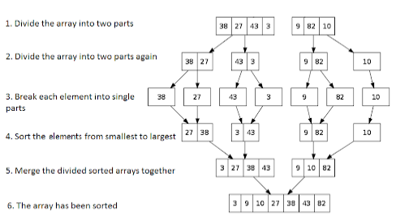
Merge Sort
Uses Divide and Conquer strategy

Slide 64
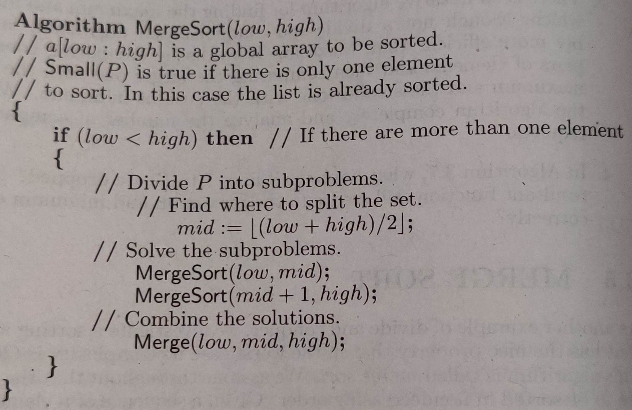
Merge Sort

Slide 65
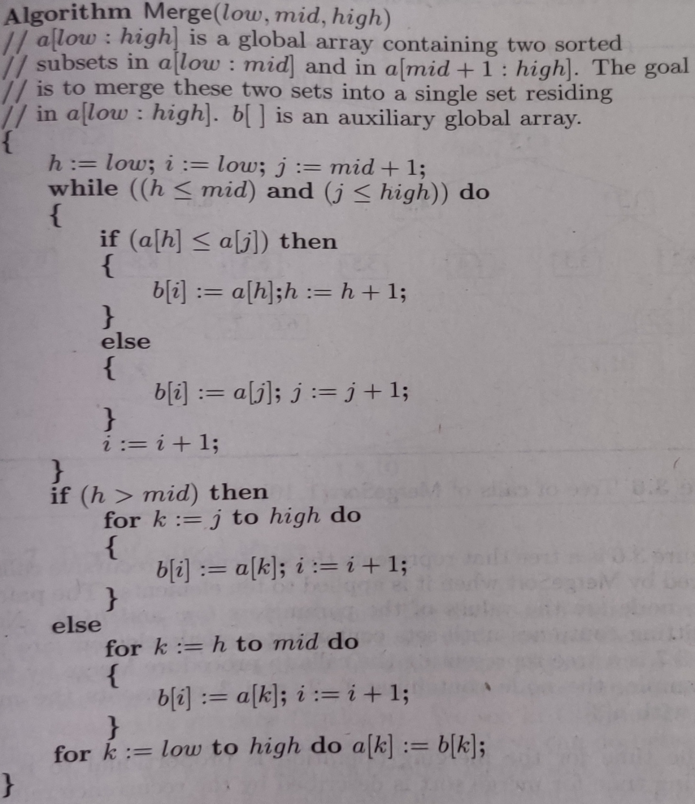
Merge Sort
h-> j->
1 2 3 4 5
A[low] A[mid] A[high]
B[i]

Slide 66
Merge sort Example
Ex:{310,285,179,652,351,423,861,254,450,520}

Slide 67
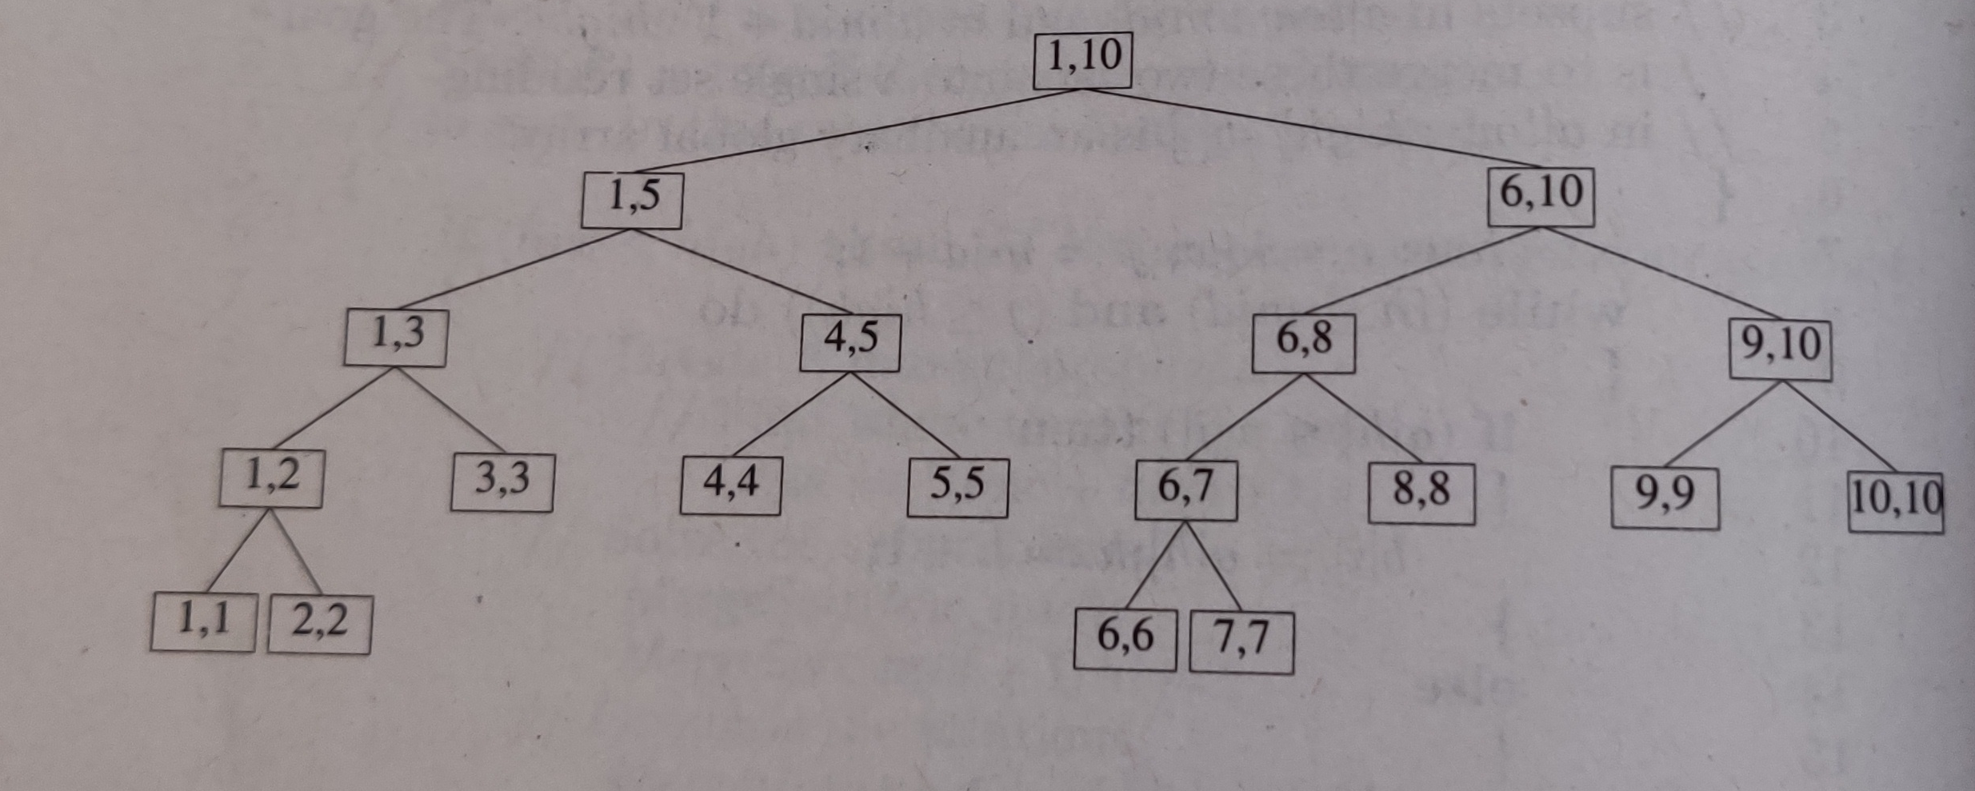
Merge Sort Example

Slide 68
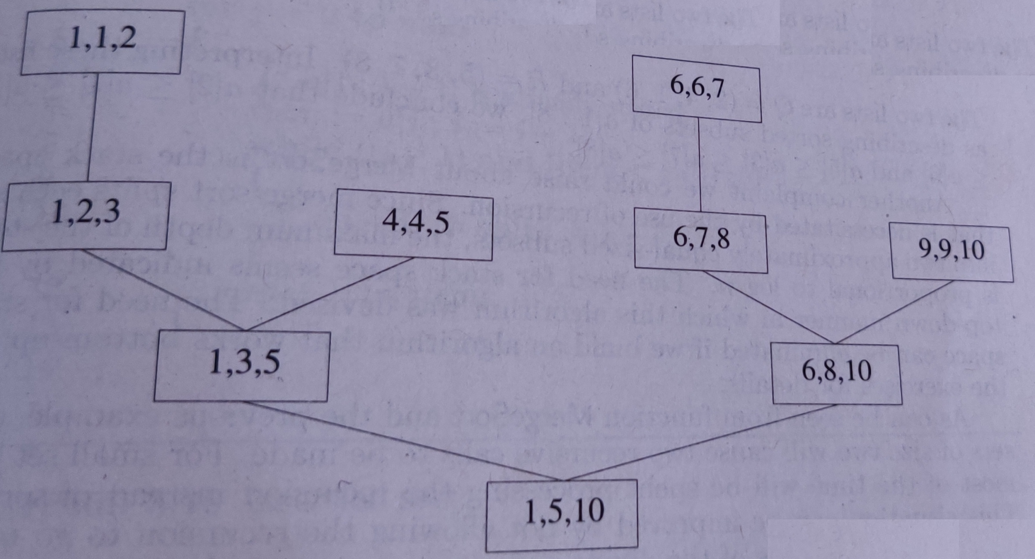
Merge Sort Example

Slide 69
Merge Sort Example
310,285,179,652,351,423,861,254,450,520
285,310,179,652,351,423,861,254,450,520
179,285,310,652,351,423,861,254,450,520
179,285,310,351,652,423,861,254,450,520
179,285,310,351,652,423,861,254,450,520
179,285,310,351,652,423,861,254,450,520
179,285,310,351,652,254,423,861,450,520
179,285,310,351,652,254,423,861,450,520
179,285,310,351,652,254,423,450,520,861
179,254,285,310,351,423,450,520,652,861

Slide 70
Merge Sort Time Complexity
T(n)=
T(n)= 2T(n/2)+cn
=2(2T(n/4)+cn/2)+cn
=2(4T(n/8)+cn/4)+2cn
=8T(n/8)+3cn
=2^{k}T(1)+kcn
=an+ nclogn [n=2^{k}]
=O(nlogn)
2T(n/2)+cn n>1, c-constant
a n=1, a-constant

Slide 71
Quick Sort
Uses divide and conquer.
It finds the element called pivot which divides the array into two halves.
Elements in the left half are smaller than pivot and elements in the right half are greater than pivot.
Three steps
Find pivot that divides the array into two halves.
Quick sort the left half.
Quick sort the right half.

Slide 72
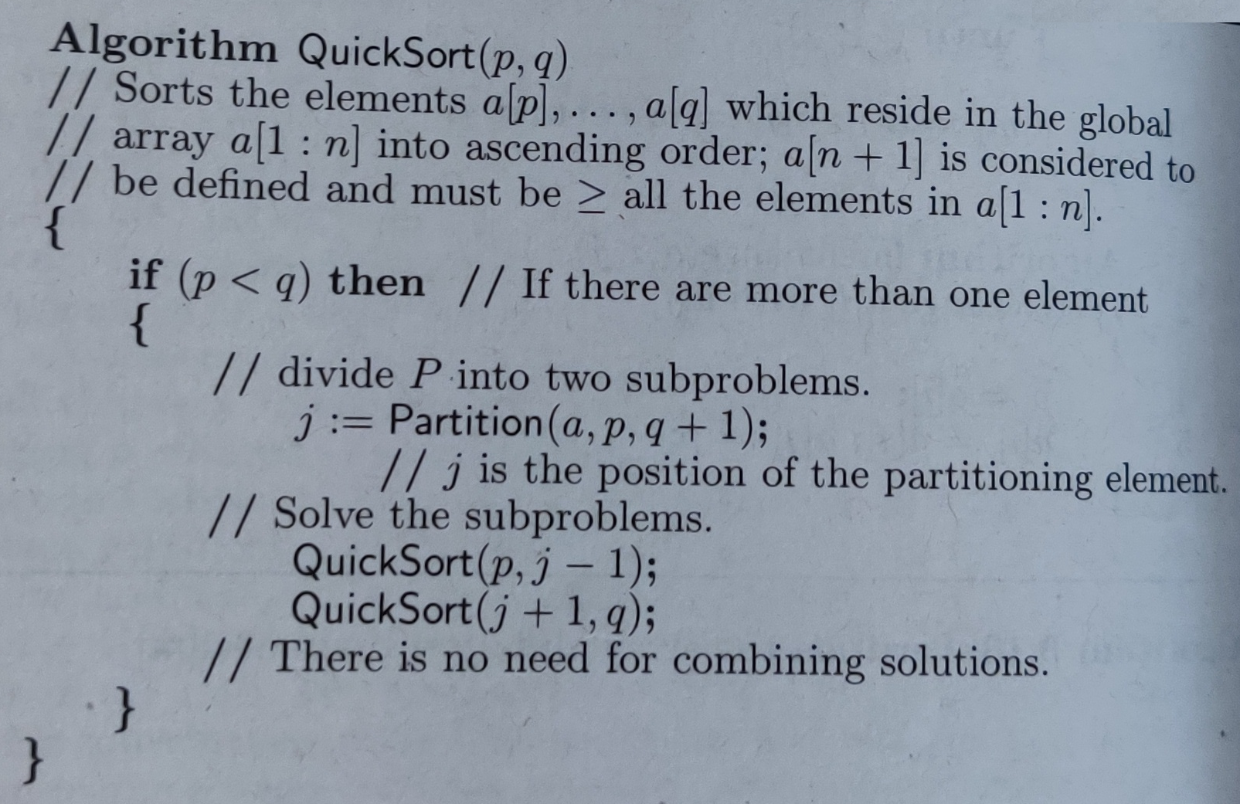
Quick Sort

Slide 73
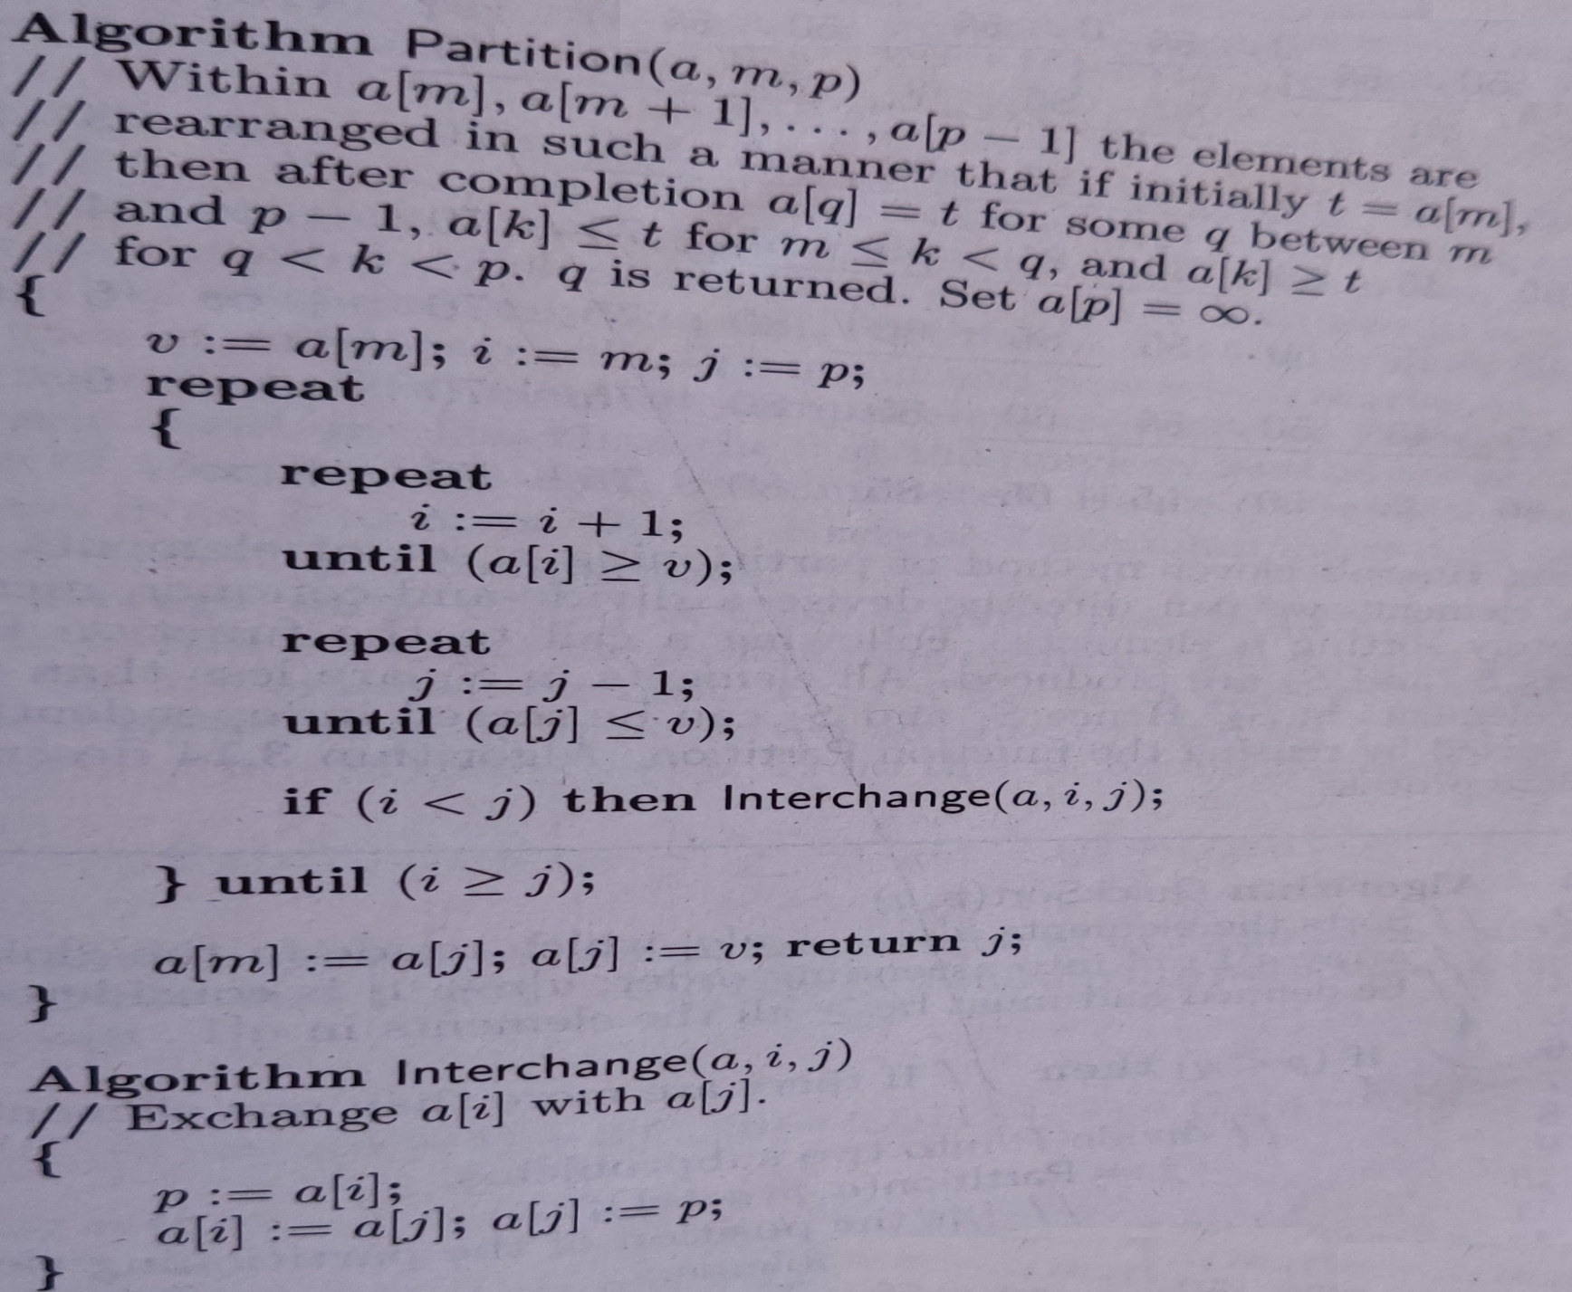
Quick Sort

Slide 74
Example
data={40,20,10,80,60,50,7,30,100}
pivot_index = 0
40
20
10
80
60
50
7
30
100
[1] [2] [3] [4] [5] [6] [7] [8] [9]
i
j

Slide 75
While data[i] <= data[pivot]
++i
pivot_index = 0
40
20
10
80
60
50
7
30
100
[0] [1] [2] [3] [4] [5] [6] [7] [8]
i
j

Slide 76
While data[i] <= data[pivot]
++i
pivot_index = 0
40
20
10
80
60
50
7
30
100
[0] [1] [2] [3] [4] [5] [6] [7] [8]
i
j

Slide 77
While data[i] <= data[pivot]
++i
pivot_index = 0
40
20
10
80
60
50
7
30
100
[0] [1] [2] [3] [4] [5] [6] [7] [8]
i
j

Slide 78
While data[i] <= data[pivot]
++i
While data[j] > data[pivot]
--j
pivot_index = 0
40
20
10
80
60
50
7
30
100
[0] [1] [2] [3] [4] [5] [6] [7] [8]
i
j

Slide 79
While data[i] <= data[pivot]
++i
While data[j] >= data[pivot]
--j
pivot_index = 0
40
20
10
80
60
50
7
30
100
[0] [1] [2] [3] [4] [5] [6] [7] [8]
i
j

Slide 80
While data[i] <= data[pivot]
++i
While data[j] > data[pivot]
--j
If i < j
swap data[i] and data[j]
pivot_index = 0
40
20
10
80
60
50
7
30
100
[0] [1] [2] [3] [4] [5] [6] [7] [8]
i
j

Slide 81
While data[i] <= data[pivot]
++i
While data[j] > data[pivot]
--j
If i < j
swap data[i] and data[j]
pivot_index = 0
40
20
10
30
60
50
7
80
100
[0] [1] [2] [3] [4] [5] [6] [7] [8]
i
j

Slide 82
While data[i] <= data[pivot]
++i
While data[j] > data[pivot]
--j
If i < j
swap data[i] and data[j]
While j > i, go to 1.
pivot_index = 0
40
20
10
30
60
50
7
80
100
[0] [1] [2] [3] [4] [5] [6] [7] [8]
i
j

Slide 83
While data[i] <= data[pivot]
++i
While data[j] > data[pivot]
--j
If i < j
swap data[i] and data[j]
While j > i, go to 1.
pivot_index = 0
40
20
10
30
60
50
7
80
100
[0] [1] [2] [3] [4] [5] [6] [7] [8]
i
j

Slide 84
While data[i] <= data[pivot]
++i
While data[j] > data[pivot]
--j
If i < j
swap data[i] and data[j]
While j > i, go to 1.
pivot_index = 0
40
20
10
30
60
50
7
80
100
[0] [1] [2] [3] [4] [5] [6] [7] [8]
i
j

Slide 85
While data[i] <= data[pivot]
++i
While data[j] > data[pivot]
--j
If i < j
swap data[i] and data[j]
While j > i, go to 1.
pivot_index = 0
40
20
10
30
60
50
7
80
100
[0] [1] [2] [3] [4] [5] [6] [7] [8]
i
j

Slide 86
While data[i] <= data[pivot]
++i
While data[j] > data[pivot]
--j
If i < j
swap data[i] and data[j]
While j > i, go to 1.
pivot_index = 0
40
20
10
30
60
50
7
80
100
[0] [1] [2] [3] [4] [5] [6] [7] [8]
i
j

Slide 87
While data[i] <= data[pivot]
++i
While data[j] > data[pivot]
--j
If i < j
swap data[i] and data[j]
While j > i, go to 1.
pivot_index = 0
40
20
10
30
60
50
7
80
100
[0] [1] [2] [3] [4] [5] [6] [7] [8]
i
j

Slide 88
While data[i] <= data[pivot]
++i
While data[j] > data[pivot]
--j
If i < j
swap data[i] and data[j]
While j > i, go to 1.
pivot_index = 0
40
20
10
30
7
50
60
80
100
[0] [1] [2] [3] [4] [5] [6] [7] [8]
i
j

Slide 89
While data[i] <= data[pivot]
++i
While data[j] > data[pivot]
--j
If i < j
swap data[i] and data[j]
While j > i, go to 1.
pivot_index = 0
40
20
10
30
7
50
60
80
100
[0] [1] [2] [3] [4] [5] [6] [7] [8]
i
j

Slide 90
While data[i] <= data[pivot]
++i
While data[j] > data[pivot]
--j
If i < j
swap data[i] and data[j]
While j > i, go to 1.
pivot_index = 0
40
20
10
30
7
50
60
80
100
[0] [1] [2] [3] [4] [5] [6] [7] [8]
i
j

Slide 91
While data[i] <= data[pivot]
++i
While data[j] > data[pivot]
--j
If i < j
swap data[i] and data[j]
While j > i, go to 1.
pivot_index = 0
40
20
10
30
7
50
60
80
100
[0] [1] [2] [3] [4] [5] [6] [7] [8]
i
j

Slide 92
While data[i] <= data[pivot]
++i
While data[j] > data[pivot]
--j
If i < j
swap data[i] and data[j]
While j > i, go to 1.
pivot_index = 0
40
20
10
30
7
50
60
80
100
[0] [1] [2] [3] [4] [5] [6] [7] [8]
i
j

Slide 93
While data[i] <= data[pivot]
++i
While data[j] > data[pivot]
--j
If i < j
swap data[i] and data[j]
While j > i, go to 1.
pivot_index = 0
40
20
10
30
7
50
60
80
100
[0] [1] [2] [3] [4] [5] [6] [7] [8]
i
j

Slide 94
While data[i] <= data[pivot]
++i
While data[j] > data[pivot]
--j
If i < j
swap data[i] and data[j]
While j > i, go to 1.
pivot_index = 0
40
20
10
30
7
50
60
80
100
[0] [1] [2] [3] [4] [5] [6] [7] [8]
i
j

Slide 95
While data[i] <= data[pivot]
++i
While data[j] > data[pivot]
--j
If i < j
swap data[i] and data[j]
While j > i, go to 1.
pivot_index = 0
40
20
10
30
7
50
60
80
100
[0] [1] [2] [3] [4] [5] [6] [7] [8]
i
j

Slide 96
While data[i] <= data[pivot]
++i
While data[j] > data[pivot]
--j
If i < j
swap data[i] and data[j]
While j > i, go to 1.
pivot_index = 0
40
20
10
30
7
50
60
80
100
[0] [1] [2] [3] [4] [5] [6] [7] [8]
i
j

Slide 97
While data[i] <= data[pivot]
++i
While data[j] > data[pivot]
--j
If i < j
swap data[i] and data[j]
While j > i, go to 1.
Swap data[j] and data[pivot_index]
pivot_index = 0
40
20
10
30
7
50
60
80
100
[0] [1] [2] [3] [4] [5] [6] [7] [8]
i
j

Slide 98
While data[i] <= data[pivot]
++i
While data[j] > data[pivot]
--j
If i < j
swap data[i] and data[j]
While j > i, go to 1.
Swap data[j] and data[pivot_index]
7
20
10
30
40
50
60
80
100
pivot_index = 5
[0] [1] [2] [3] [4] [5] [6] [7] [8]
i
j

Slide 99
Partition Result
7
20
10
30
40
50
60
80
100
[0] [1] [2] [3] [4] [5] [6] [7] [8]
<= data[pivot]
> data[pivot]

Slide 100
Recursion: Quicksort Sub-arrays
7
20
10
30
40
50
60
80
100
[0] [1] [2] [3] [4] [5] [6] [7] [8]
<= data[pivot]
> data[pivot]

Slide 101
Example
A={65,70,75,80,85,60,55,50,45}

Slide 102
Quick Sort

Slide 103
Quick Sort

Slide 104
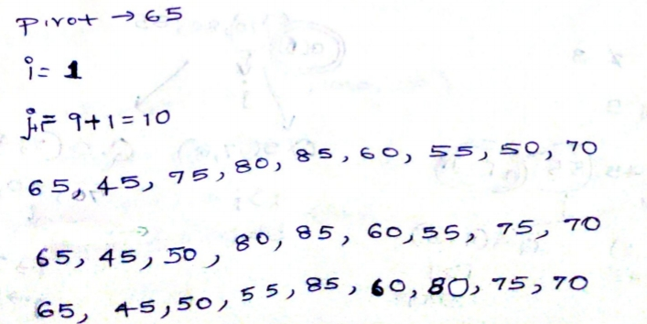
Solution

Slide 105
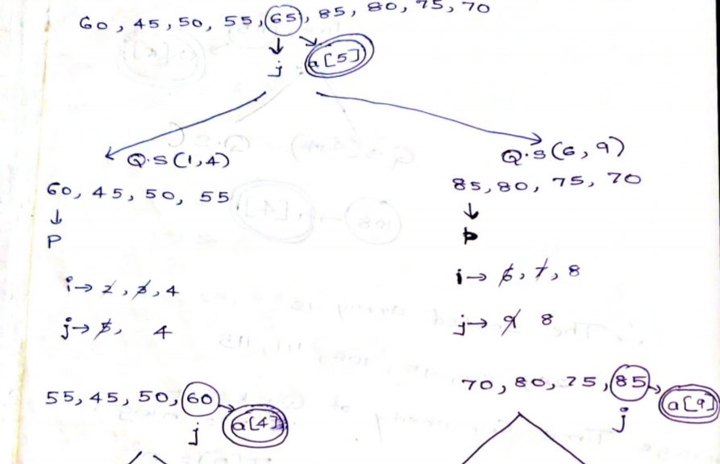
Solution

Slide 106
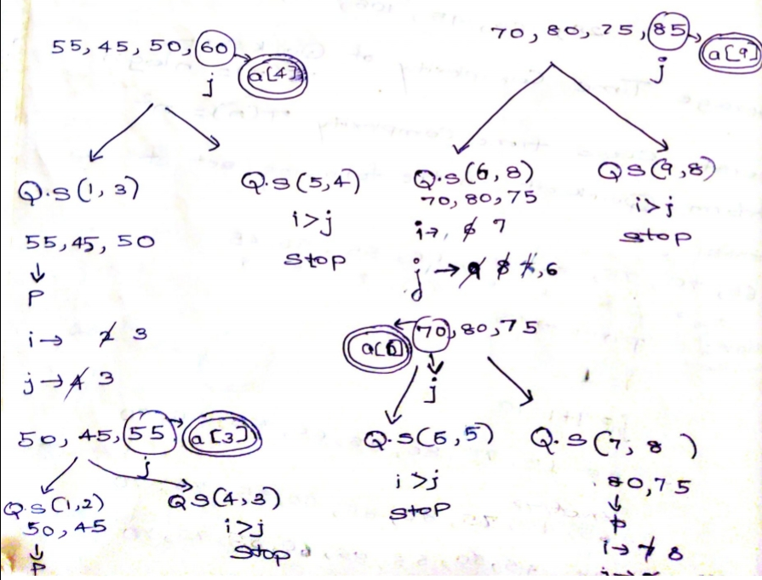
Solution

Slide 107
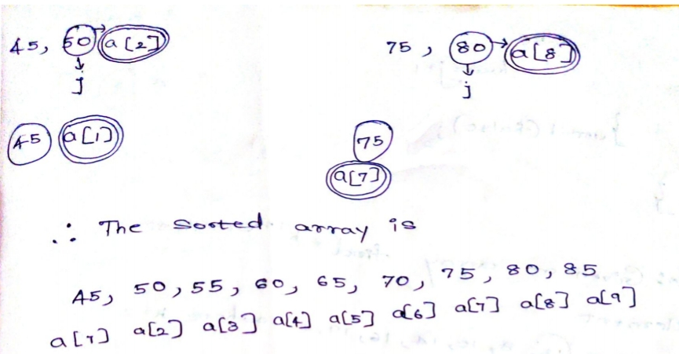
Solution

Slide 108
Time Complexity
Best case running time: Ω(n log₂n)
T(n)=T(n/2)+T(n/2)+n
Worst case running time: O(n²)

Slide 109
Example of Worst Case Time Complexity
Quick sort has worst time complexity when the elements in the list are already sorted.
pivot_index = 0
2
4
10
12
13
50
57
63
100
[1] [2] [3] [4] [5] [6] [ 7] [8] [9]
too_big_index
too_small_index

Slide 110
Example of Worst Case Time Complexity
T(n)=n+(n-1)+(n-2)+….+2=n(n+1)/2=O(n²)
pivot_index = 0
2
4
10
12
13
50
57
63
100
[1] [2] [3] [4] [5] [6] [7] [8] [9]
<= data[pivot]
> data[pivot]

Slide 111
Selection: Finding kth smallest element
Select a pivot and partition the array with pivot at correct position j
If position of pivot, j, is equal to k, return A[j].
If j is less than k, discard array from start to j, and look for (k-j)^{th} smallest element in right sub array, go to step 1.
If j is greater than k, discard array from j to end and look for k^{th} element in left subarray, go to step 1

Slide 112
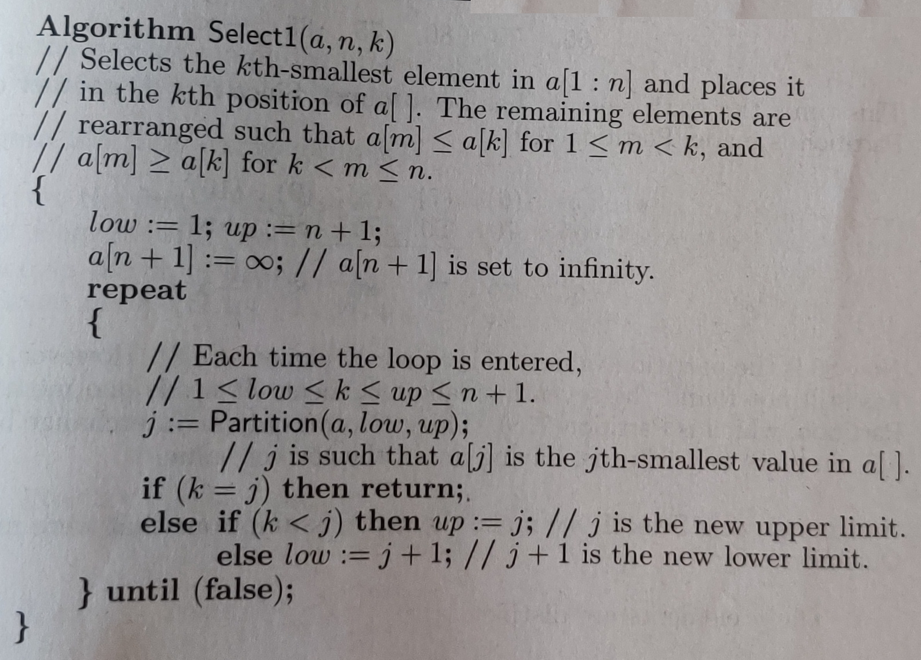
Selection: Finding kth smallest element
 |  | A[j]
1
2
j
4
5

Slide 113
Selection: Finding kth smallest element
Ex:{12,8,10,14,16,19,3}
Find second smallest element in this array.

Slide 114
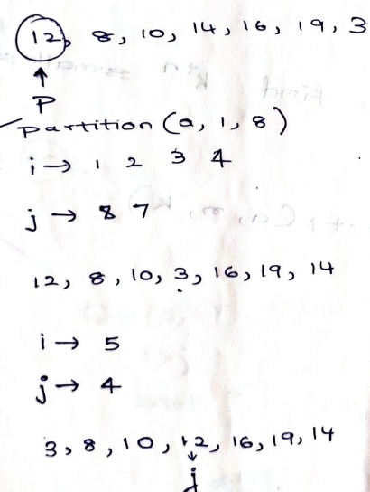
Selection: Finding kth smallest element

Slide 115
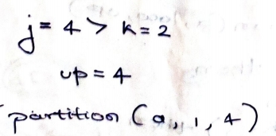
Selection: Finding kth smallest element

Slide 116
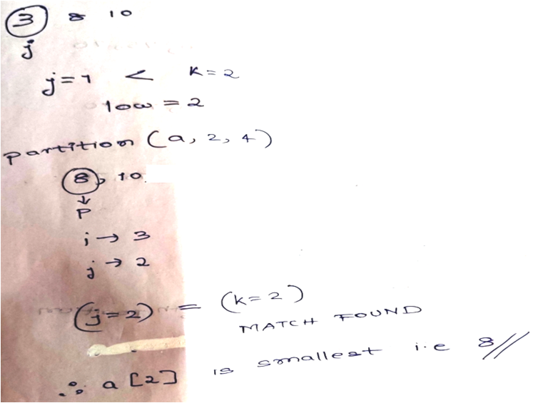
Selection: Finding kth smallest element

Slide 117
Finding kth Smallest Element Time Complexity
Time complexity of finding kth smallest element in list is O(nlogn)
The worst case time complexity of the above solution is still O(n²).

Slide 118
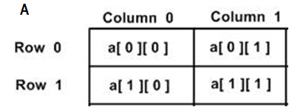
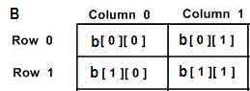
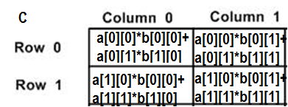
Strassen’s Matrix Multiplication
Naïve Matrix Mutiplication
for (int i = 0; i < N; i++)
{
for (int j = 0; j < N; j++)
{
C[i][j] = 0;
for (int k = 0; k < N; k++)
{
C[i][j] += A[i][k]*B[k][j];
}
}
}

Slide 119
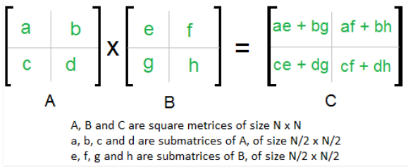
Divide and Conquer Matrix Multiplication
Following is simple Divide and Conquer method to multiply two square matrices: 1) Divide matrices A and B in 4 sub-matrices of size N/2 x N/2 as shown in the below diagram. 2) Calculate following values recursively. ae + bg, af + bh, ce + dg and cf + dh.
T(N) = 8T(N/2) + O(N²)
8-Multiplication
N²-Addition

Slide 120
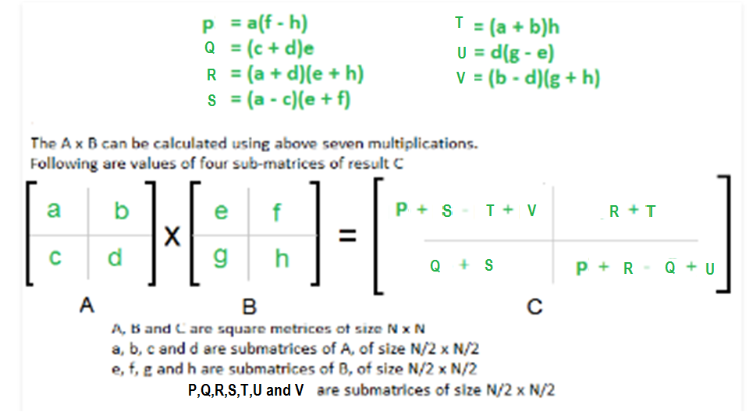
Strassen’s Matrix Multiplication
Time Complexity= T(n)=7T(N/2) + O(N²)

Slide 121
Strassen’s Time Complexity
T(N) = 7T(N/2) + O(N²)
From Master's Theorem,
a=7, b=2,d=2
a>b^{d} , Hence T(n)=N ^{log} _{b} ª
O(N^{Log7}) which is approximately O(N^{2.8074})

Slide 122
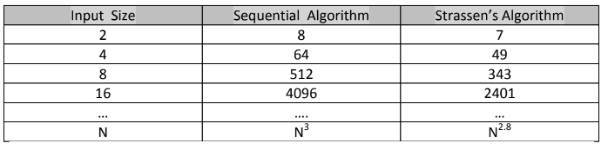
Performance Enhancement with Strassens

Slide 123
Strassen’s Matrix Multiplication Example
1.Perform matrix multiplication using Strassen’s method.
A=
B=
2 3
3 2
4 3
3 4

Slide 124
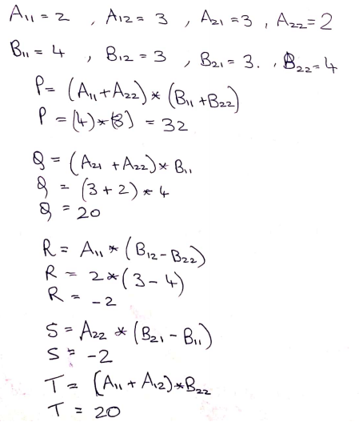
Strassen’s Matrix Multiplication Example

Slide 125
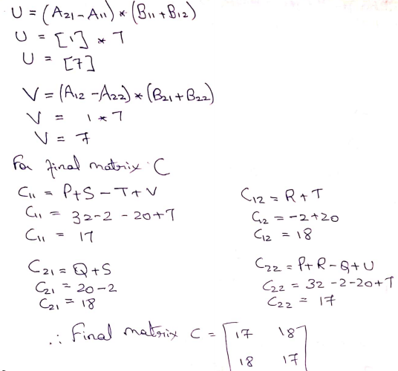
Strassen’s Matrix Multiplication Example

Slide 126
Strassen’s Matrix Multiplication Example
1)Solve matrix multiplication using Strassens multiplication
A=
B=
2 1 1 3
6 0 4 5
3 2 1 8
4 3 2 1
1 0 0 3
2 1 1 6
7 1 8 3
0 5 4 0

Slide 127
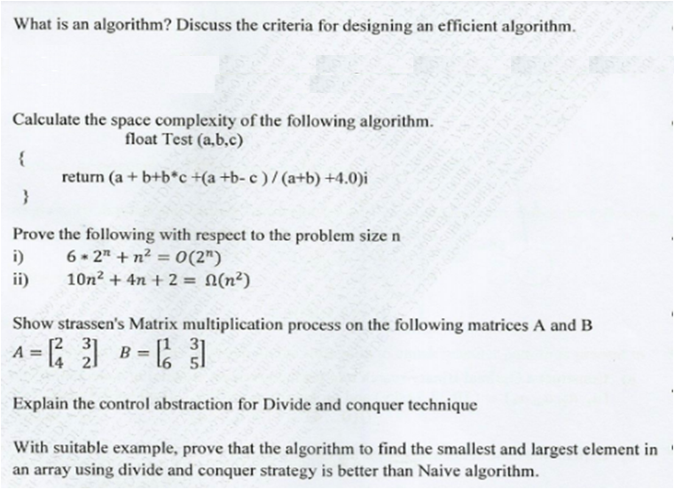
Questions Asked

Slide 128
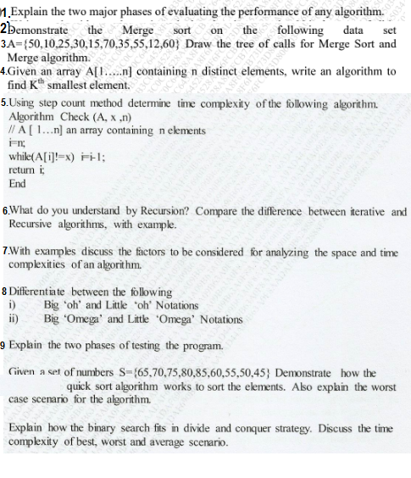
Questions Asked

Slide 129
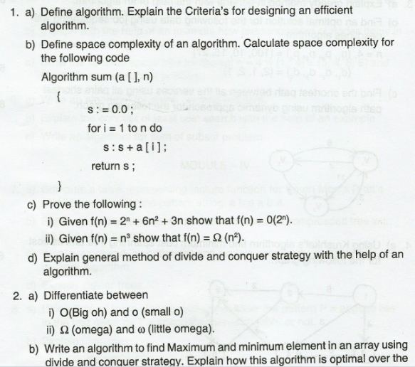
Questions Asked

Slide 130
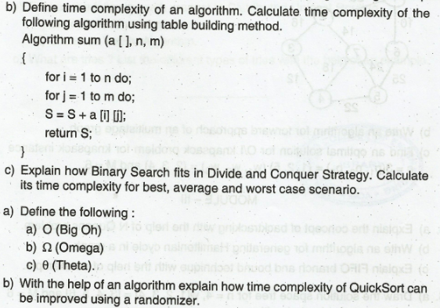
Questions Asked

Slide 131
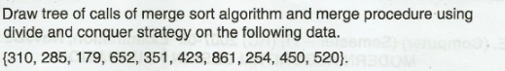
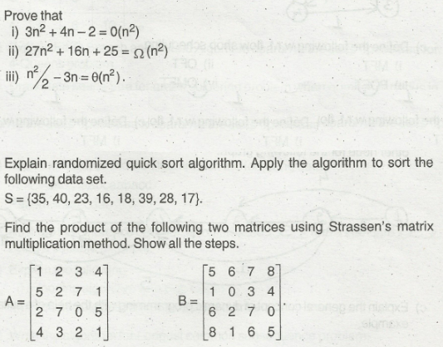
Questions Asked

Slide 132
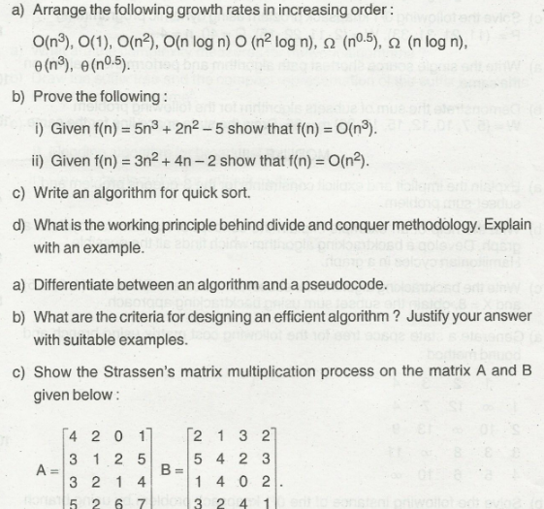
Questions Asked

Slide 133
Text Books
1 Fundamentals of Computer Algorithms – E. Horowitz et al, 2nd Edition UP.- Divide and Conquer Strategy
2. Introduction to Algorithms, 3th Edition, Thomas H Cormen, Charles E Lieserson, Ronald L Rivest and Clifford Stein, MIT Press/McGraw-Hill.- Recurrence Relation
3. Design and Analysis of Algorithm –V. V Muniswamy- Problems on Recurrence Relation(Reference Book)

Slide 134
Thank You

Slide 135
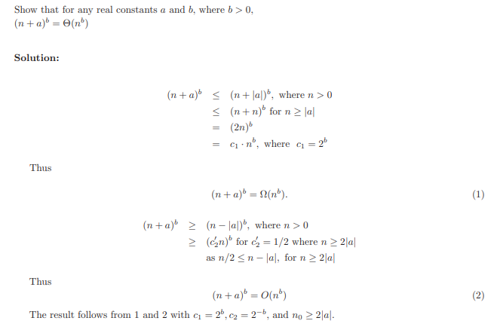
Some Additional Problems

Slide 136
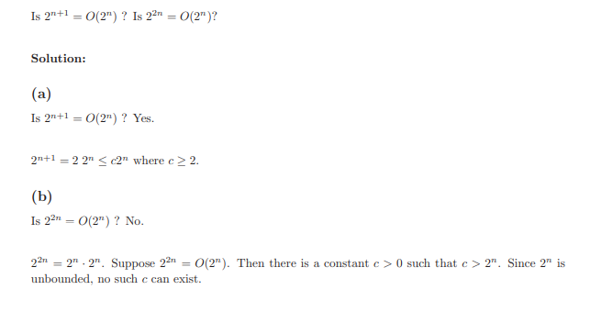
Some Additional Problems

Slide 137
Hierarchy of functions
1, log₂n, ³√n, √n, n, nlog₂n, n√n, n², n³, 2^{n}, n!, n^{n}
Each one is Big-Oh of any function to its right

Slide 138
Basic Rules of Logarithms
If log_{z} (x) = a, then x = zª
log_{z} (xy)
log_{z} (x/y)
log_{z} (x^{y})
If x = y
If x < y
log_{z} (-|x|) is undefined
= log_{z} (x) + log_{z} (y)
= log_{z} (x) - log_{z} (y)
= ylog_{z} (x)
then log_{z} (x) = log_{z} (y)
then log_{z} (x) < log_{z} (y)

Slide 139
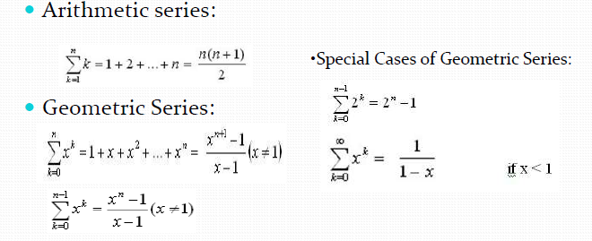
Some Equations

Slide 140
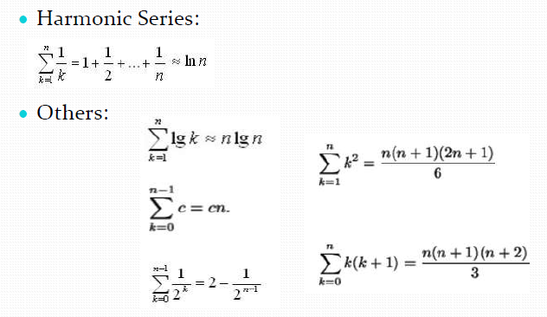
Some Equations

